Slide 1



ASCEND
Arizona State University
2017-2018

Slide 2
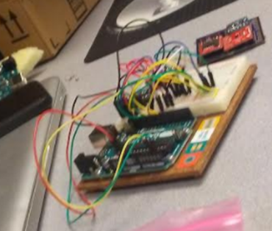
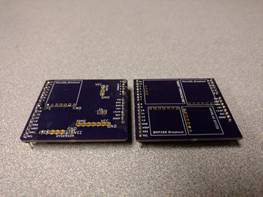
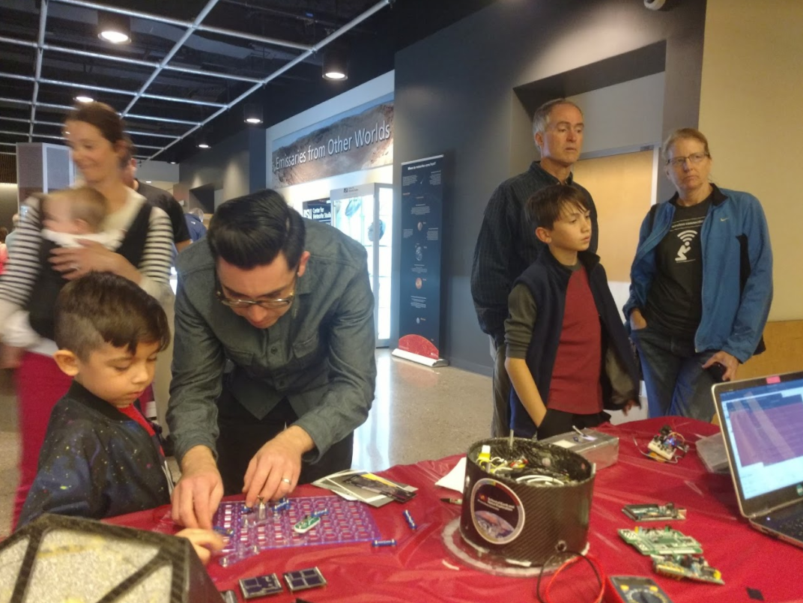
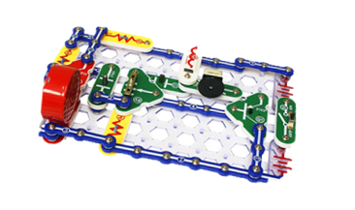
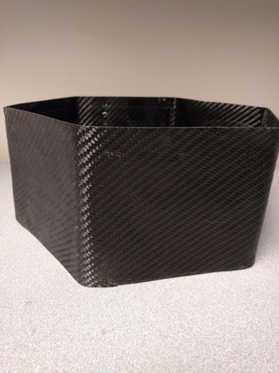
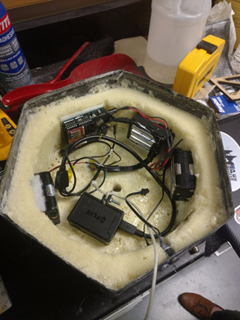
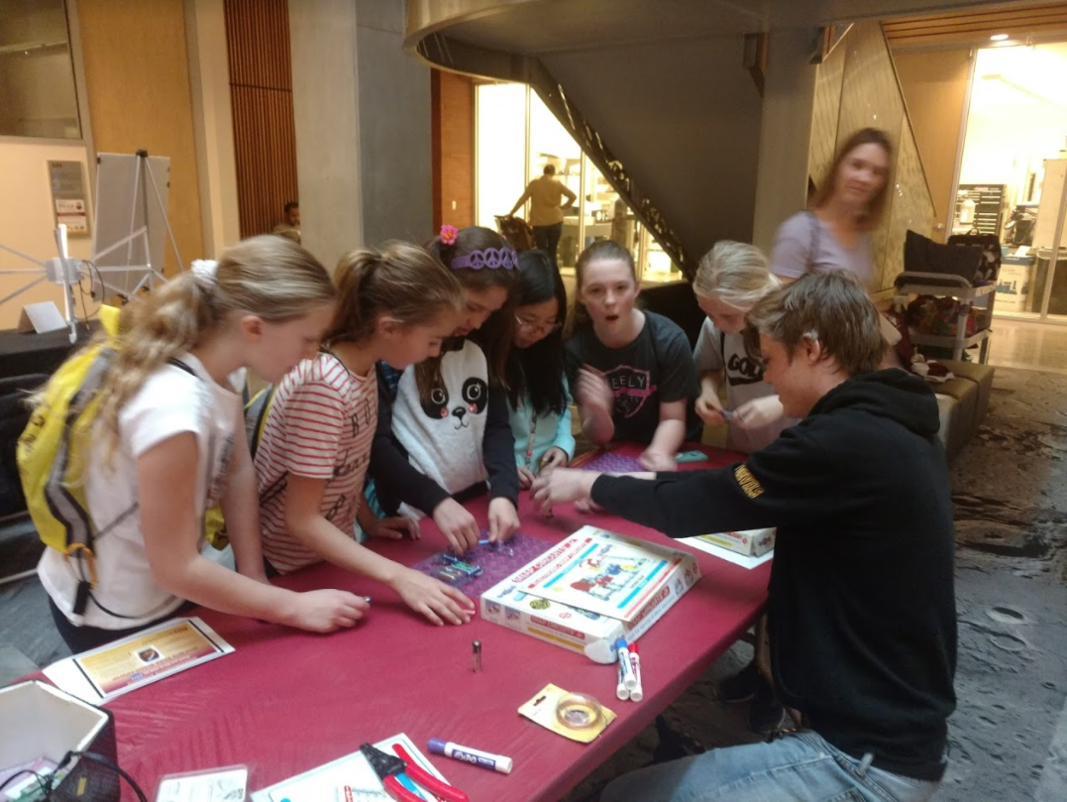
Learning Workshop & Outreach

Slide 3
Fall 2017
Spring 2018
Learning Workshop Continued
Learning Workshop
Design
Working with Carbon Fiber
Circuitry & Code
Data analysis
Post-flight
Speed of sound system failed to log to SD card due to a loose wire
Full flight data retrieved
Camera failure (FireFly)
Ball-bearing rotation reduction success
Post-flight
Recovered data from corrupt SD card via Linux
Full flight data and video(FLIR) retrieved
HD Wing camera SD card came out during flight

Slide 4
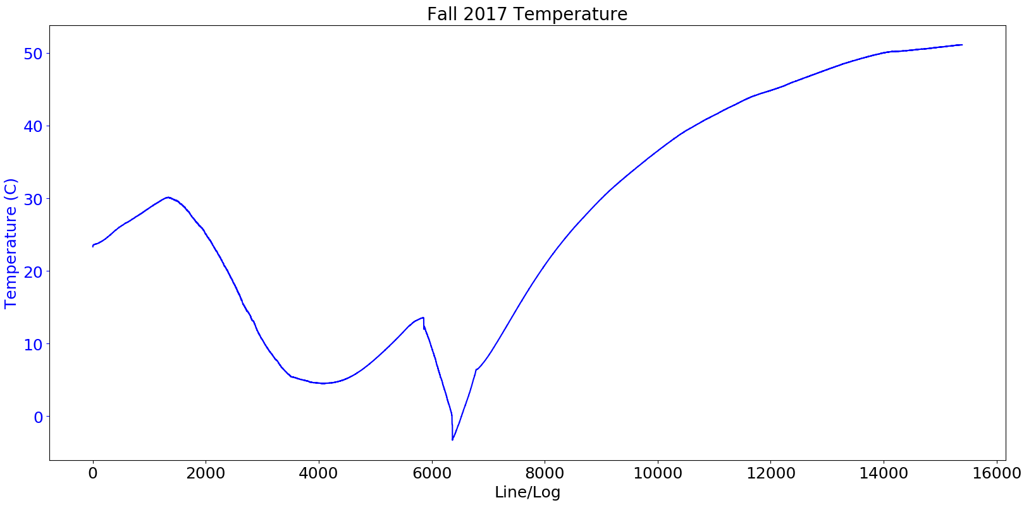
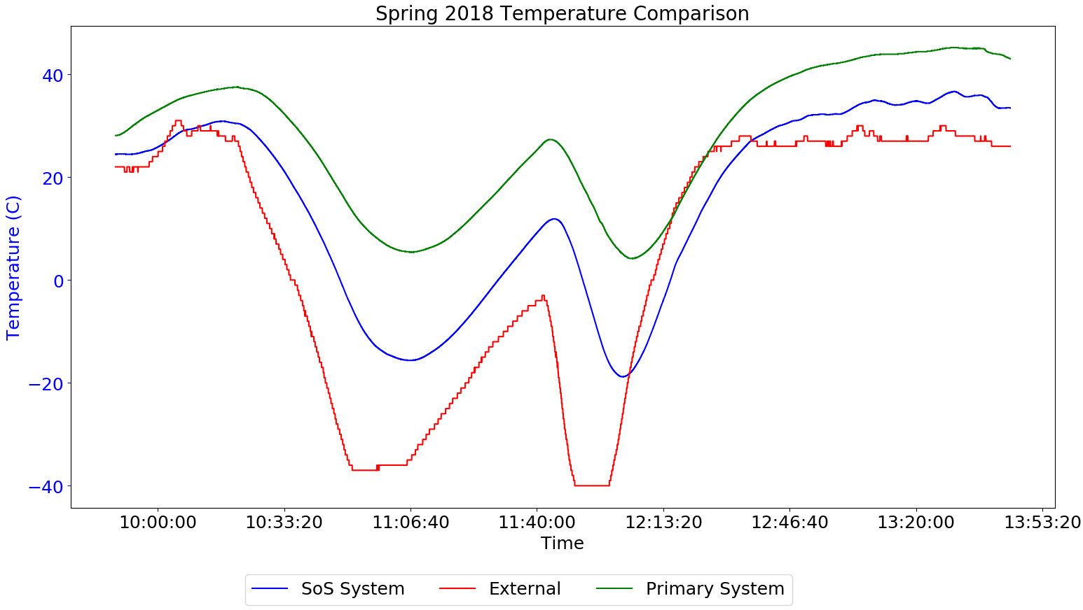
System Temperature
Fall 2017: Internal temperature of payload did not go below -5 Celsius
Spring 2018: Revealed temperatures with varying insulation inside payload

Slide 5
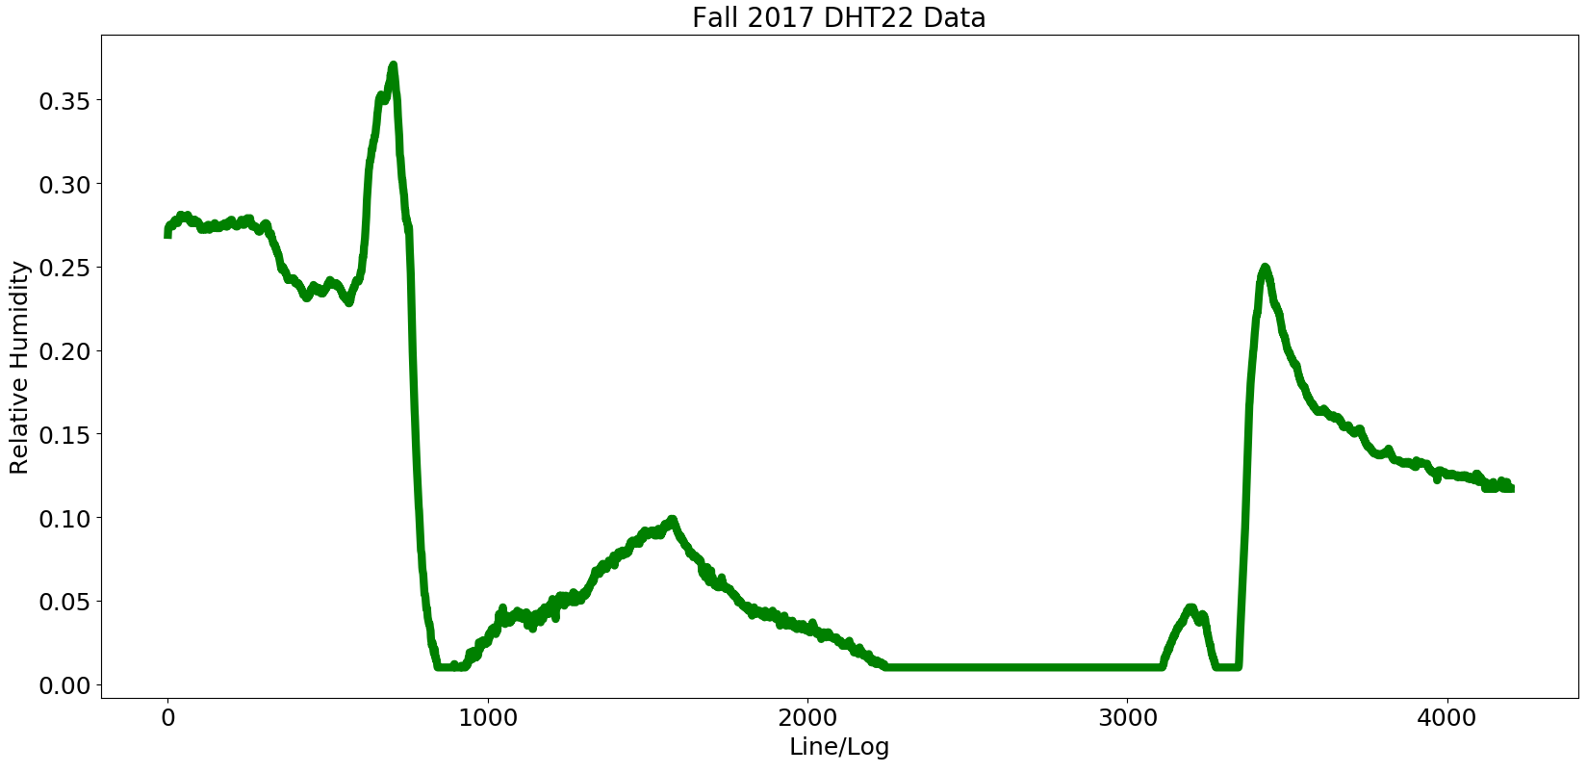
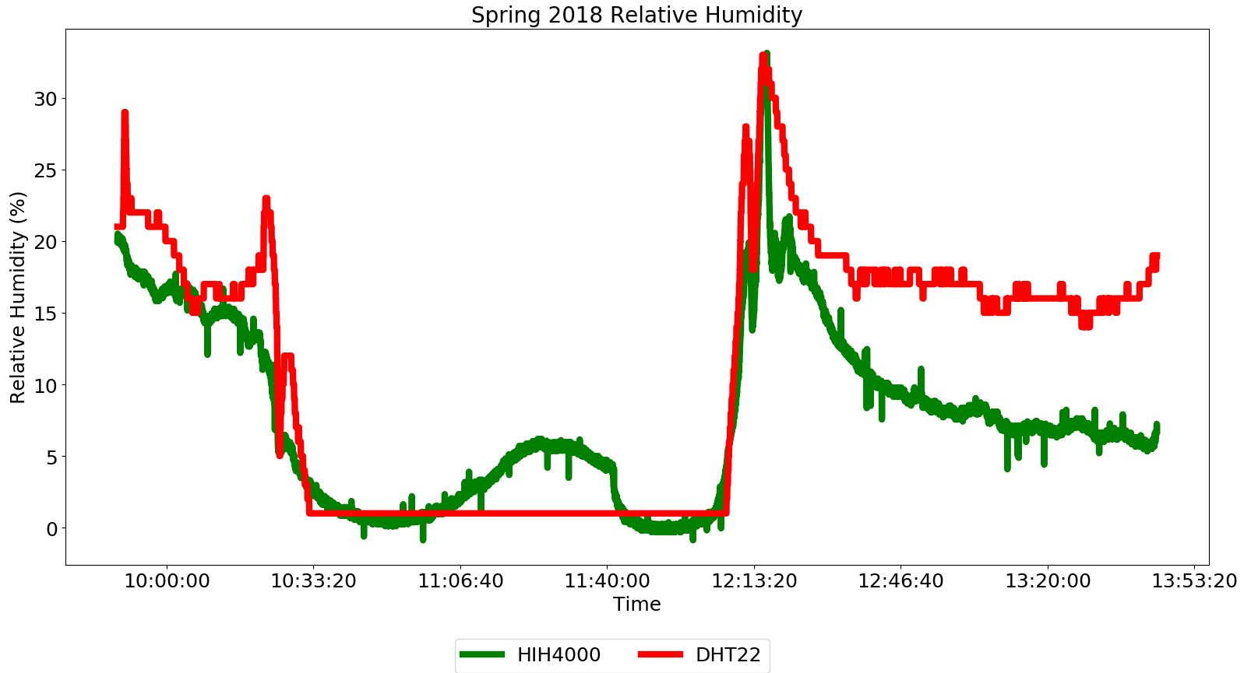
Fall 2017
Spring 2018
Possible faulty DHT22 sensor due to repeated usage in ASCEND flights
New DHT22 Sensor
Additional HIH-4000 Analog Sensor

Slide 6
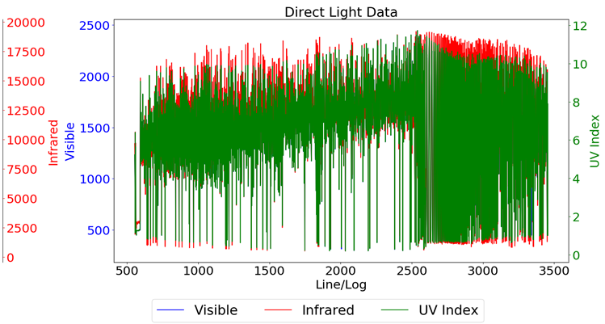
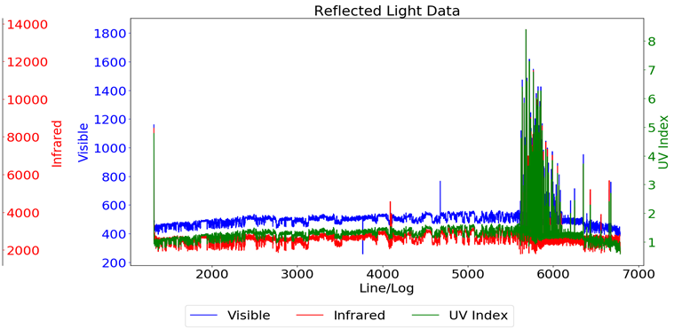
Light Data
Both graphs from Fall 2017 flight from Adafruit SI1145 Sensor
Switched to ZOPT2201 UV Sensor for Spring 2018 flight
  Sensor did not retrieve data due to currently unknown reasons
ZOPT2201 Issue
  If I2C addresses changed--resets to factory settings on power down

Slide 7
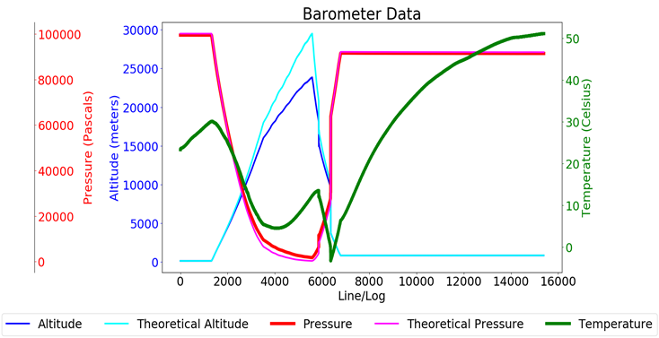
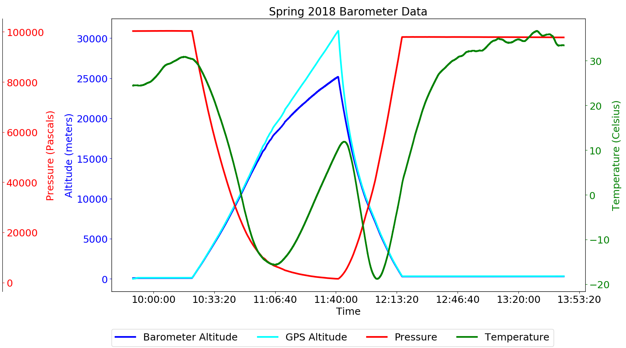
Fall 2017
Spring 2018
Learned that barometers do not operate well for altitude calculations
Calculated theoretical data values for estimated flight altitude
Pressure from Temperature formula:
101325*((1-((9.80665*T)/(1007*288.15)))^(3.50799880209))
Altitude from Pressure formula:
44330 * ( 1 - ( P / 101325 ) ^ ( 1 / 5.255 ) )
Solution: Added a GPS for accurate altitude data and time tracking

Slide 8
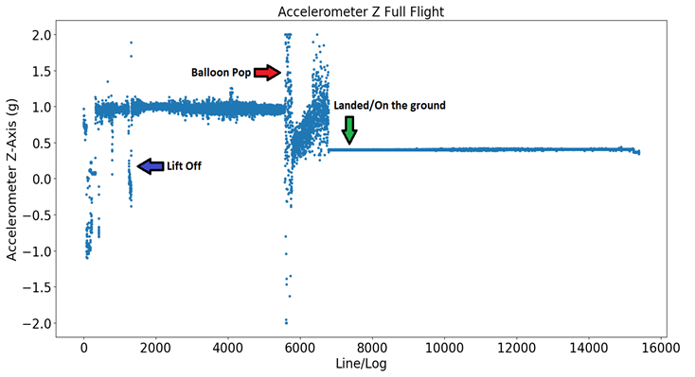
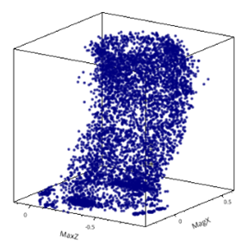
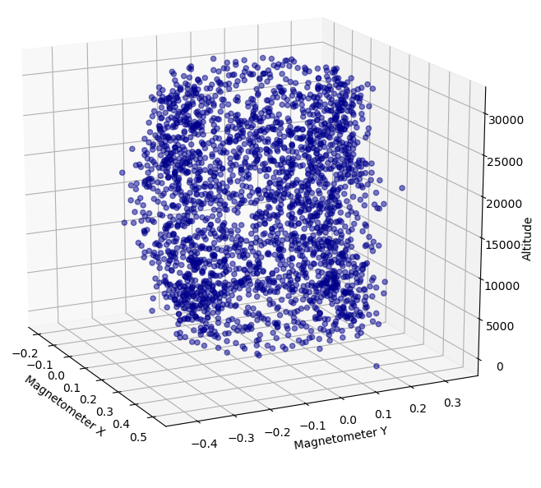
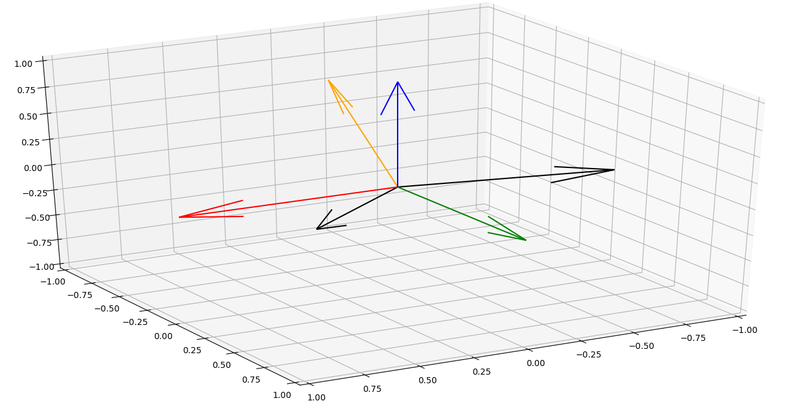
Motion Data
Fall 2017 Accelerometer
Payload experienced 4g’s briefly after pop
Animated data for visualization and analysis of ball bearing effectiveness
Magnetometer XY-Plane vs Altitude
Vector analysis using Python

Slide 9

Thank you!
Special Thanks to:
Thomas Sharp, Desiree Crawl, Laura Zimmerman, Bianca Pina, Paul Ronquillo, Susan Brew, Arizona Space Grant, ANSR

